Slide 1
HPE SSD Selector Tool- Data Structure
November 2020
December 2018
Lissette Cruz
Enablement Tools Product Manager

Slide 2
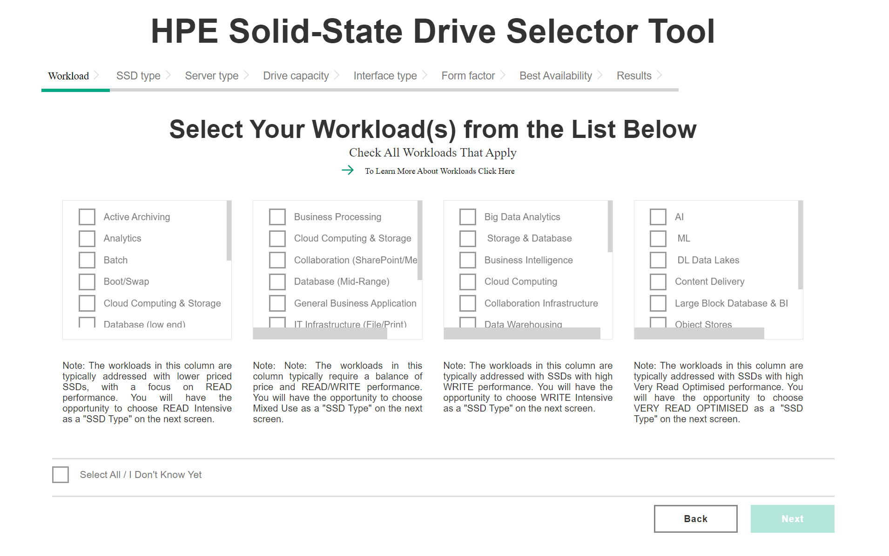
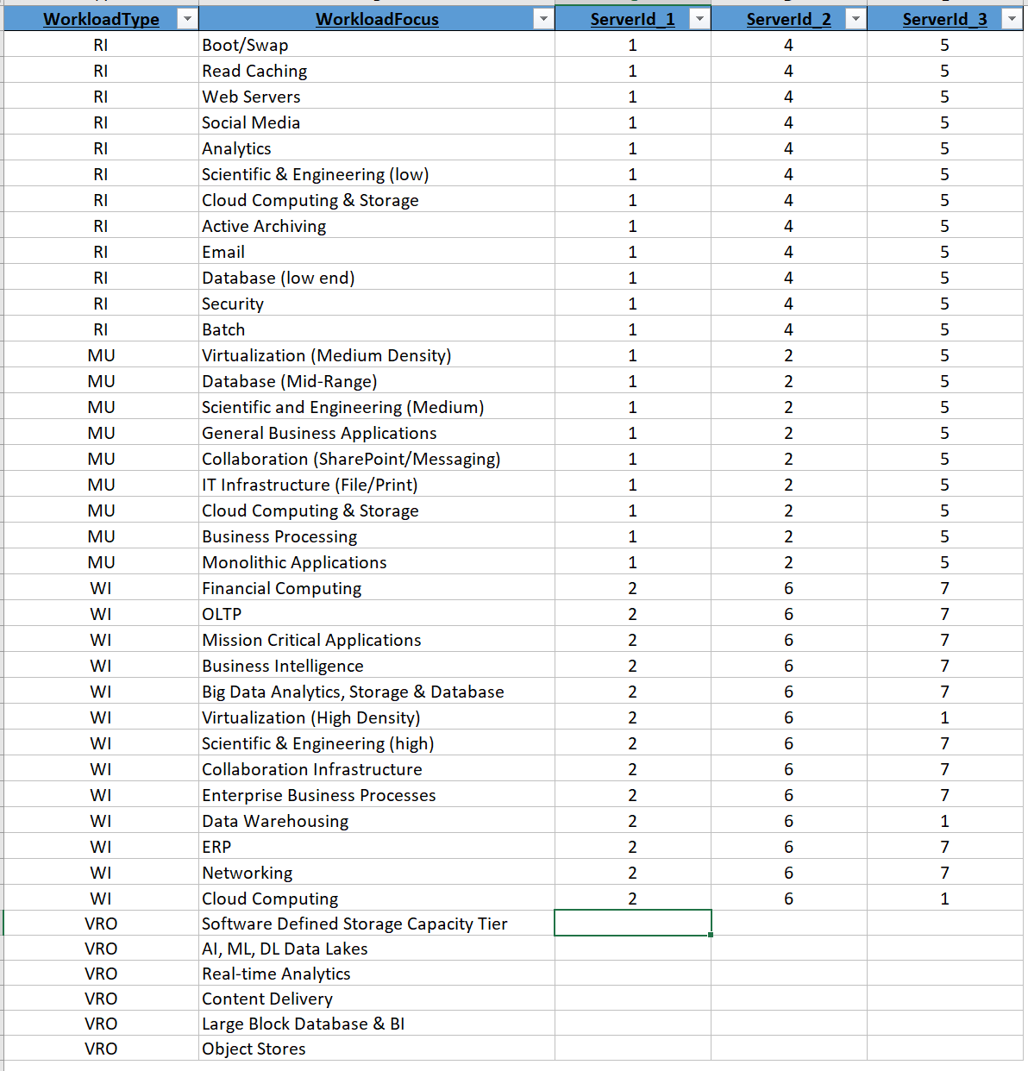
“Help me to Choose” –starting point
When user begins, the following page appears
How it relates to the “Mega file”

Slide 3
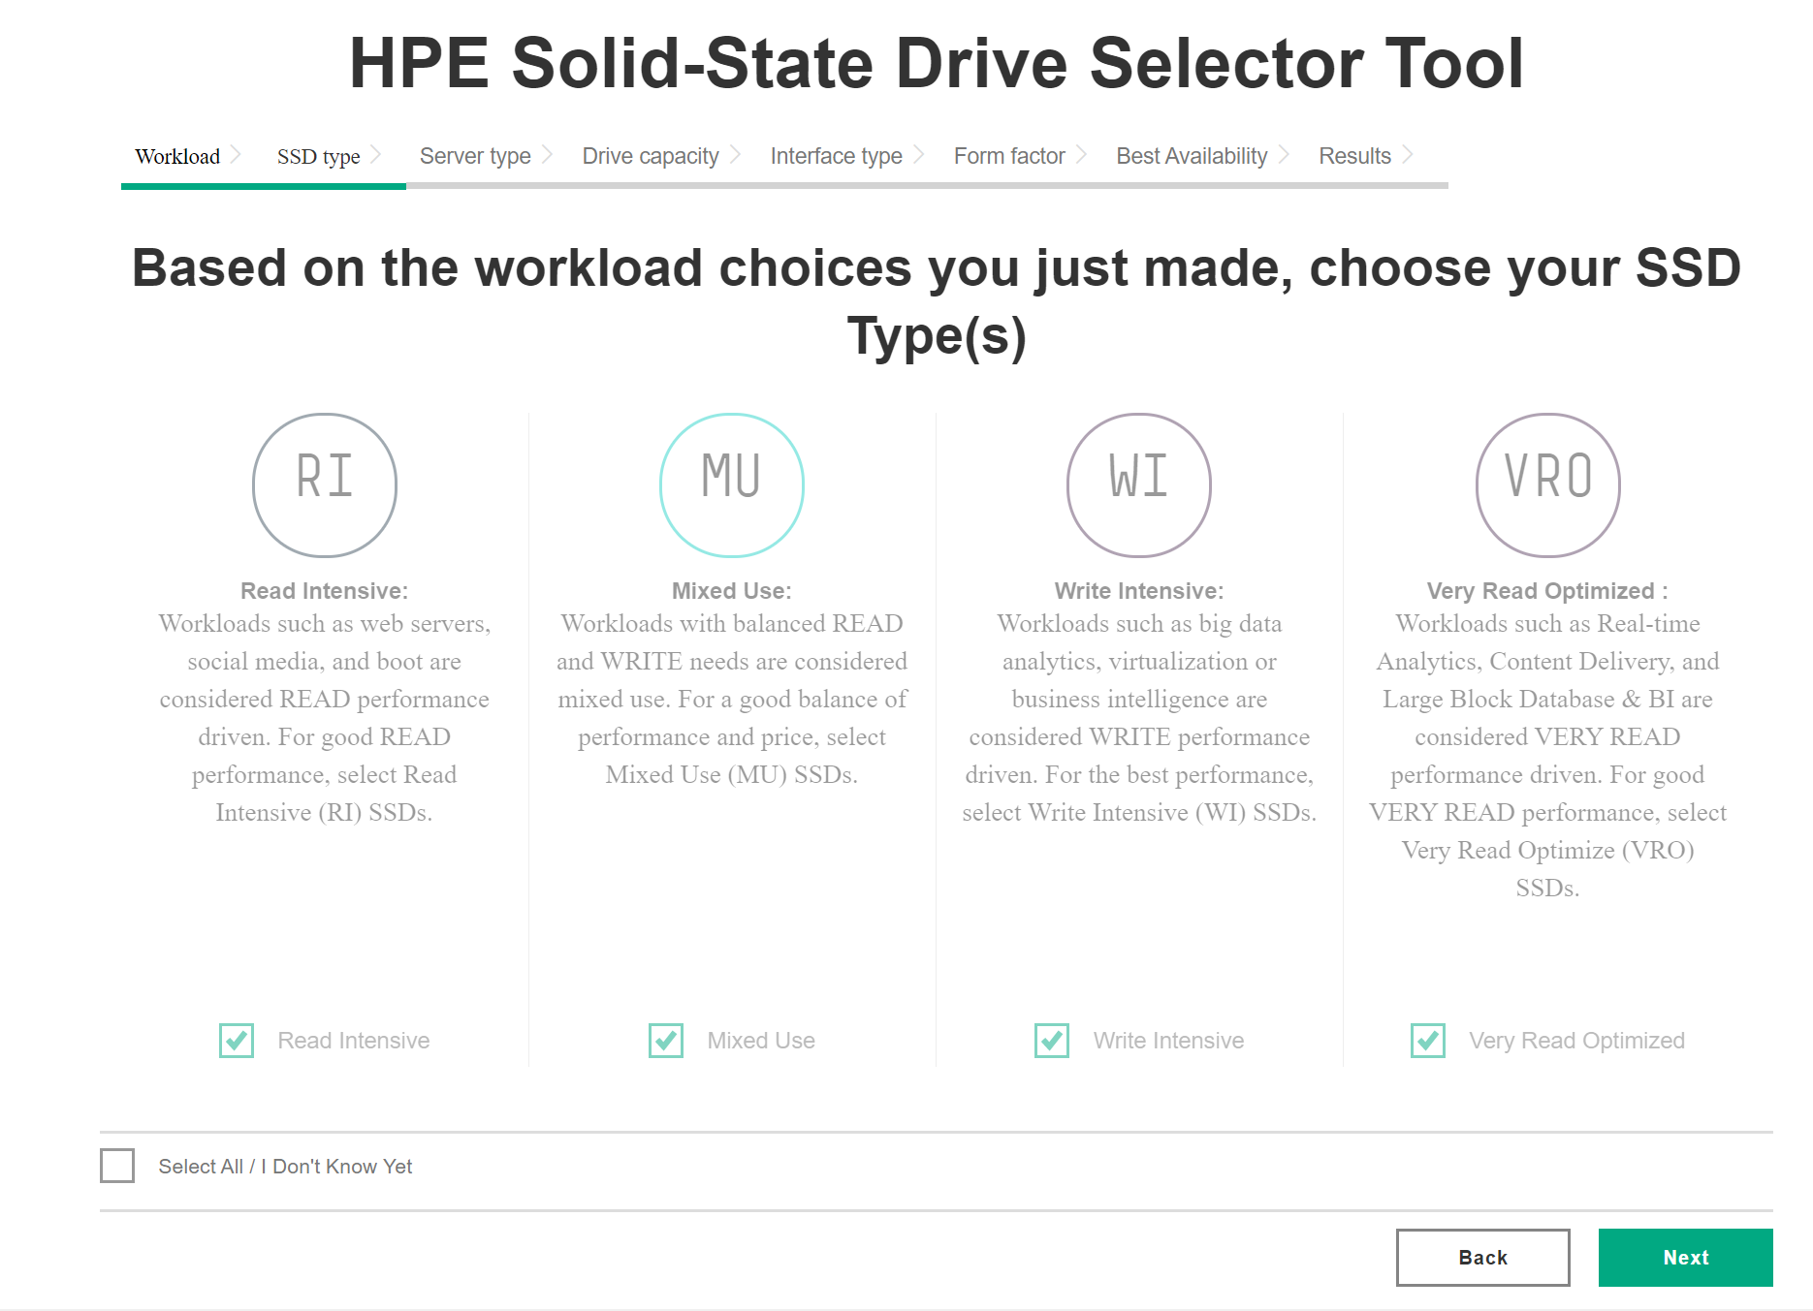
“Help me to Choose” –starting point
User is then brought to the next selection prompt
How it relates to the “Mega file”

Slide 4
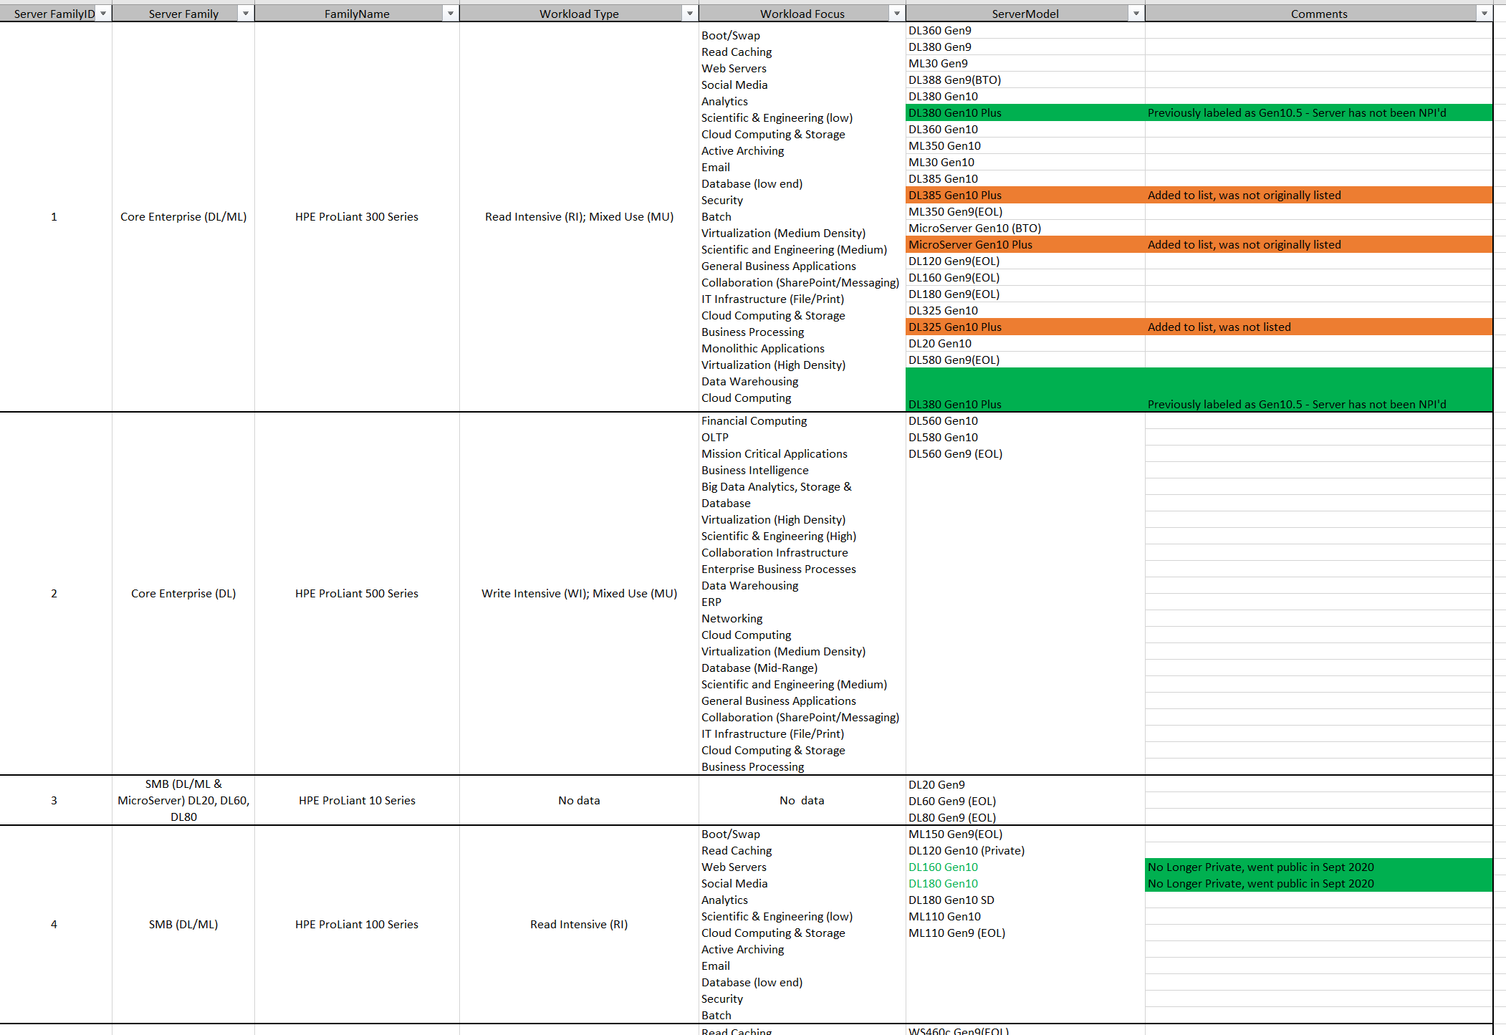
Server Family ID correlates to Server Model (Reference to first column)
Created a new reference file for developers to follow.

